Slide 1

Department of Electronics & Communication Engineering
25SC2107E - Machine Learning
Project Presentation
Presented by:
B. Sahithi - 2520040111
V. Pranathi - 2520040104
V. Bhargavi – 2520040048
Guide: N. Lava Prasad Sir

Slide 2
Fidelity-Aware Safe Reinforcement Learning
for UAV Trajectory and Communication Control

Slide 3
INTRODUCTION
• UAVs are widely used in surveillance, delivery, disaster management and wireless communication.
• A UAV should reach its destination safely while maintaining reliable communication.
• Shortest-path navigation alone may cause collisions, poor communication or unnecessary energy use.
• Our project uses reinforcement learning to learn UAV movement and communication power control.

Slide 4
PROBLEM STATEMENT
The main problem is to control a UAV so that it can reach a target while balancing four requirements:
• Safe navigation — avoid obstacles and no-fly zones.
• Target reaching — reduce the distance to the destination.
• Reliable communication — maintain sufficient SINR and communication fidelity.
• Energy efficiency — avoid unnecessary movement and communication power consumption.
Therefore, the problem is treated as a multi-objective reinforcement learning task.

Slide 5
PROPOSED METHODOLOGY / ALGORITHM
PPO — Proximal Policy Optimization
• Observation: goal direction, user direction, distances, communication fidelity, energy, obstacle clearance and progress.
• Action: X movement, Y movement and transmit power.
• Reward: positive reward for goal progress, reaching the goal, communication quality and trajectory fidelity.
• Penalties: unsafe movement, boundary violations, poor communication and energy use.
• Safety mechanism: movement into a no-fly zone is rejected.

Slide 6
PROJECT WORKFLOW / IMPLEMENTATION
1
2
3
4
5
6
→
→
→
→
→
Create UAV
simulation
Define obstacles
and safe path
Calculate SINR
and fidelity
Train PPO
agent
Evaluate learned
trajectory
Compare with
Greedy baseline
Tools: Python • Gymnasium • Stable-Baselines3 • PPO • NumPy • Pandas • Matplotlib
Training target: 100,000 timesteps

Slide 7
SIMULATION / EXPERIMENTAL SETUP
• 2-D UAV simulation environment with a 100 × 100 map.
• Start position: (10, 10); destination: (90, 90).
• Multiple circular no-fly zones are included.
• Ground user position is included for communication modelling.
• The UAV controls movement and normalized transmit power.
• Performance is evaluated using 20 test episodes and a Greedy baseline.

Slide 8
SIMULATION / EXPERIMENTAL RESULTS
Current recorded PPO evaluation from the notebook
• Total / average reward: 348.32
• Goal success rate: 0%
• Final goal distance: 22.45
• Average SINR: 13.03 dB
• Communication fidelity: 0.932
• Trajectory fidelity: 0.123
• Collisions: 0
• Boundary violations: 24

Slide 9
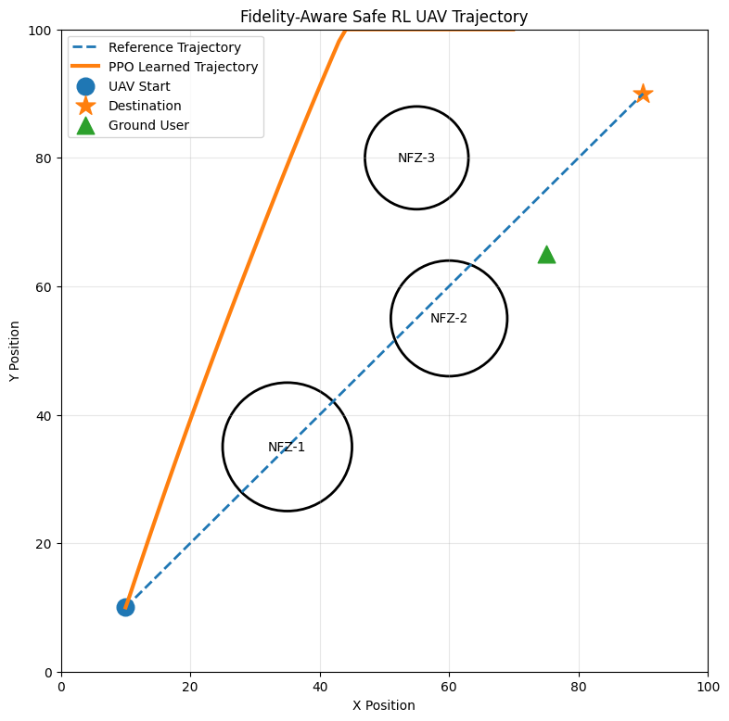
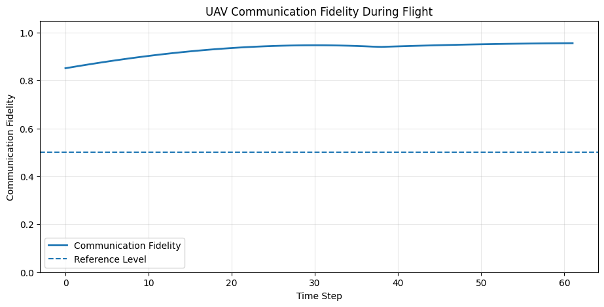
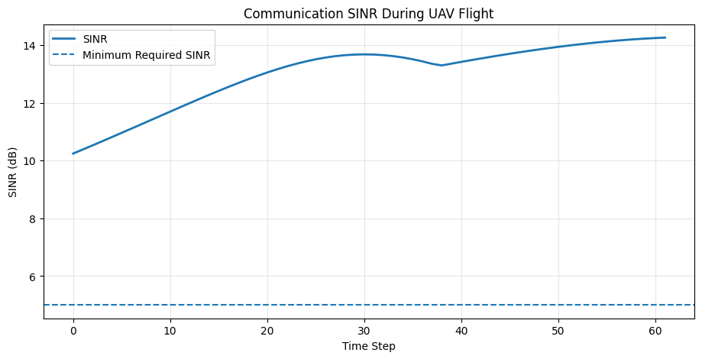
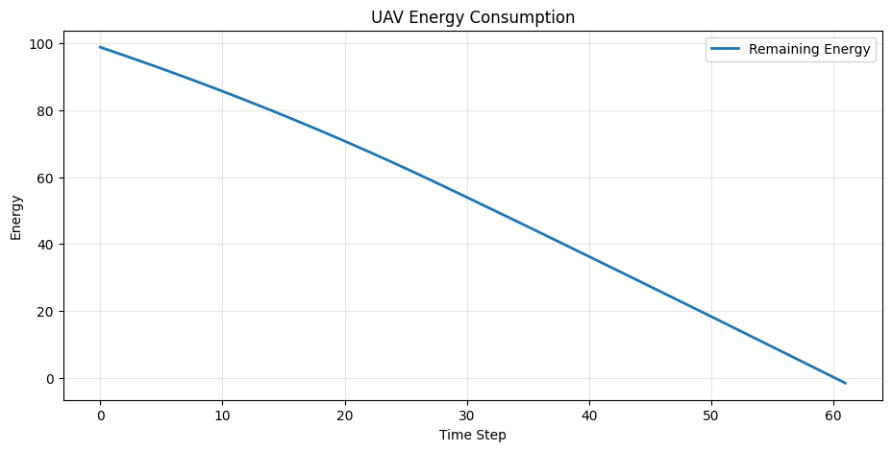
OUTPUT GRAPHS

Slide 10
CURRENT PROGRESS AND REMAINING WORK
Completed
Remaining Work
• UAV simulation environment
• Obstacle and safety handling
• Communication / SINR model
• Fidelity measures
• PPO training pipeline
• Evaluation and visualization
• Greedy baseline comparison
• Run the corrected notebook completely in Colab.
• Confirm improved goal-reaching performance.
• Record final 20-episode metrics.
• Update the report and presentation with final outputs.
• Prepare the final project demonstration.

Slide 11
CONCLUSION AND FUTURE SCOPE
• A PPO-based UAV control system was developed for trajectory and communication control.
• The system considers safety, target reaching, communication fidelity and energy together.
• A complete simulation, training and evaluation pipeline has been implemented.
• Future work includes dynamic obstacles, multiple UAVs, improved wireless channel models and real-world testing.

Slide 12
THANK YOU

